Slide 1

Vacuum
postgres

Slide 2
How is VACUUM different from autovacuum?
● VACUUM is an SQL command that performs certain maintenance operations.
● Autovacuum is a set of background processes that automatically run the VACUUM and ANALYZE commands

Slide 3
What Does VACUUM Do?
● VACUUM recycles space consumed by deleted rows and the old version versions of update rows. If this is not done, your tables and indexes will “bloat,” becoming unreasonably large.
● VACUUM allows for the reuse of transaction IDs, or XIDs, and of multi-transaction IDs, or MXIDs. If this is not done, you will eventually run out of usable XIDs or MXIDs and the system will stop accepting write transactions.
● VACUUM updates the visibility map for tables, making index-only scans and future VACUUM operations more efficient. If this is not done, there are possible performance consequences, often minor.
● In short, if you don’t run VACUUM regularly, or if it fails to accomplish the tasks that it is intended to do, bad things happen happen to your database.

Slide 4
How Does Autovacuum Work?
● There is an autovacuum launcher process which normally runs all the time.
● It keeps track of what databases exist and regularly starts autovacuum worker processes in each database.
● An autovacuum worker looks at each table in the database to which it has been instructed to connect, and it decides whether to perform VACUUM or ANALYZE on that table.

Slide 5
How Can Autovacuum Go Wrong?
● As users, we hope that autovacuum will keep our database working properly: low bloat, plenty of available XIDs, etc.
● However, autovacuum is just a system for running VACUUM and ANALYZE commands automatically according to a set of configurable parameters.
● If the configuration isn’t appropriate for the system, autovacuum may work correctly but fail to achieve the intended goals.
● Any problem with VACUUM or ANALYZE will also affect autovacuum.

Slide 6
What Problems Can VACUUM or ANALYZE Have?
● Typically, these problems happen with VACUUM, not ANALYZE. ● Could fail.
○ Then, autovacuum will keep retrying, maybe forever.
● Could run forever and never complete.
○ Then, the table won’t get vacuumed, and maybe others won’t, either.
● Could run for a really long time.
○ Same problems.
● Could finish successfully in a reasonable amount of time but without really getting any work done.
○ Then, autovacuum will keep retrying, maybe forever.

Slide 7
Problem Summary
● Slow or Stuck. VACUUM runs for a very long time on a table, maybe forever.
● Spinning. Same VACUUM is getting retried over and over again, either because either because it’s failing with an error, or because it’s succeeding but nothing useful is happening.
● Skipped. Autovacuum doesn’t think that VACUUM is required, but actually it is.
● Starvation. Autovacuum is too busy and so some tables are not getting checked.

Slide 8
Vacuum
VACUUM FULL in PostgreSQL:
VACUUM FULL is a database maintenance command in PostgreSQL that reclaims storage space by thoroughly reorganizing tables and indexes. It removes both dead tuples and empty space, resulting in compact data storage. However, it requires exclusive locks on the target table, which can impact database availability during the operation.
VACUUM FULL Command:
To use VACUUM FULL, execute the following command in PostgreSQL:
Command VACUUM FULL table_name;

Slide 9

Auto VACUUM in PostgreSQL:
Auto VACUUM is a built-in automated maintenance process in PostgreSQL that manages routine vacuum tasks to optimize database performance. Enabled by default, it automatically removes old data and updates statistics. Configuration options in the postgresql.conf file allow fine-tuning of Auto VACUUM behavior:
1-autovacuum: Enables or disables the background autovacuum process (enabled by default).
2-autovacuum_vacuum_threshold: Sets the minimum dead rows count for table vacuuming (default: 50).
3-autovacuum_analyze_threshold: Specifies the minimum live rows count for table analysis (default: 50).
4-autovacuum_vacuum_scale_factor: Multiplier triggering vacuum based on table size (default: 0.2).
5-autovacuum_analyze_scale_factor: Multiplier triggering analysis based on table size (default: 0.1).
6-autovacuum_vacuum_cost_delay: Determines autovacuum start delay (default: 20 milliseconds).
7-autovacuum_vacuum_cost_limit: Sets the maximum rows vacuumed per operation (default: 200).

Slide 10
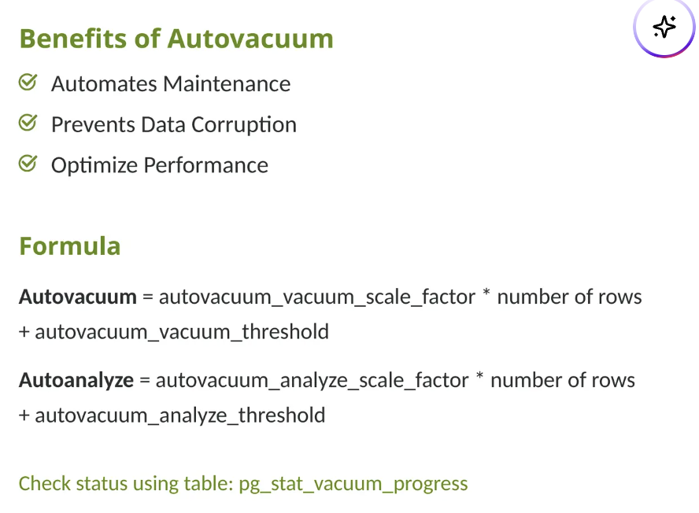
Autovacuum

Slide 11
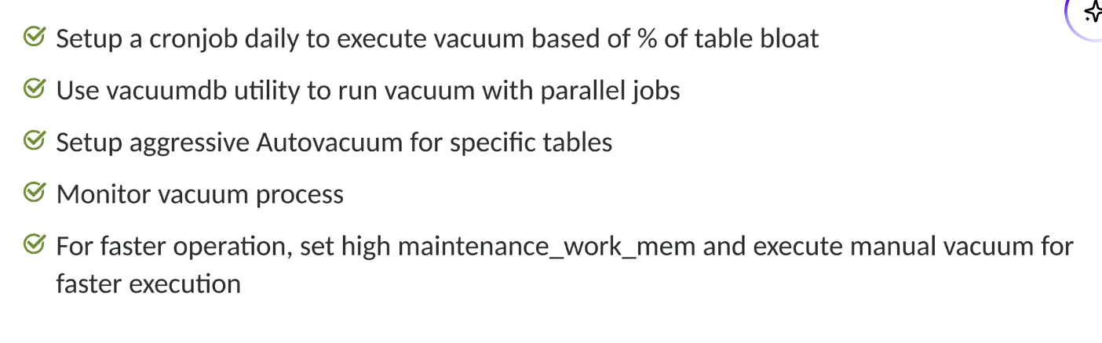
Best practices

Slide 12
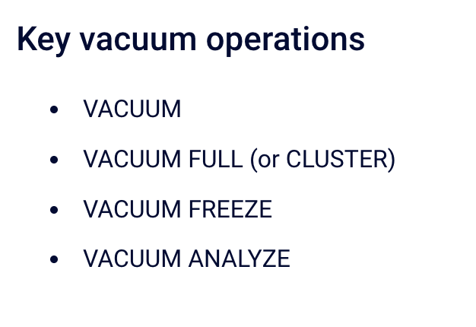
Types Vacuum

Slide 13
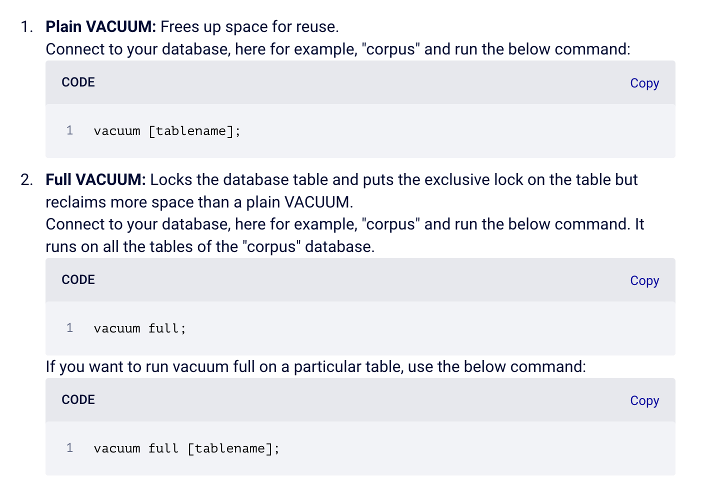
Types Vacuum

Slide 14
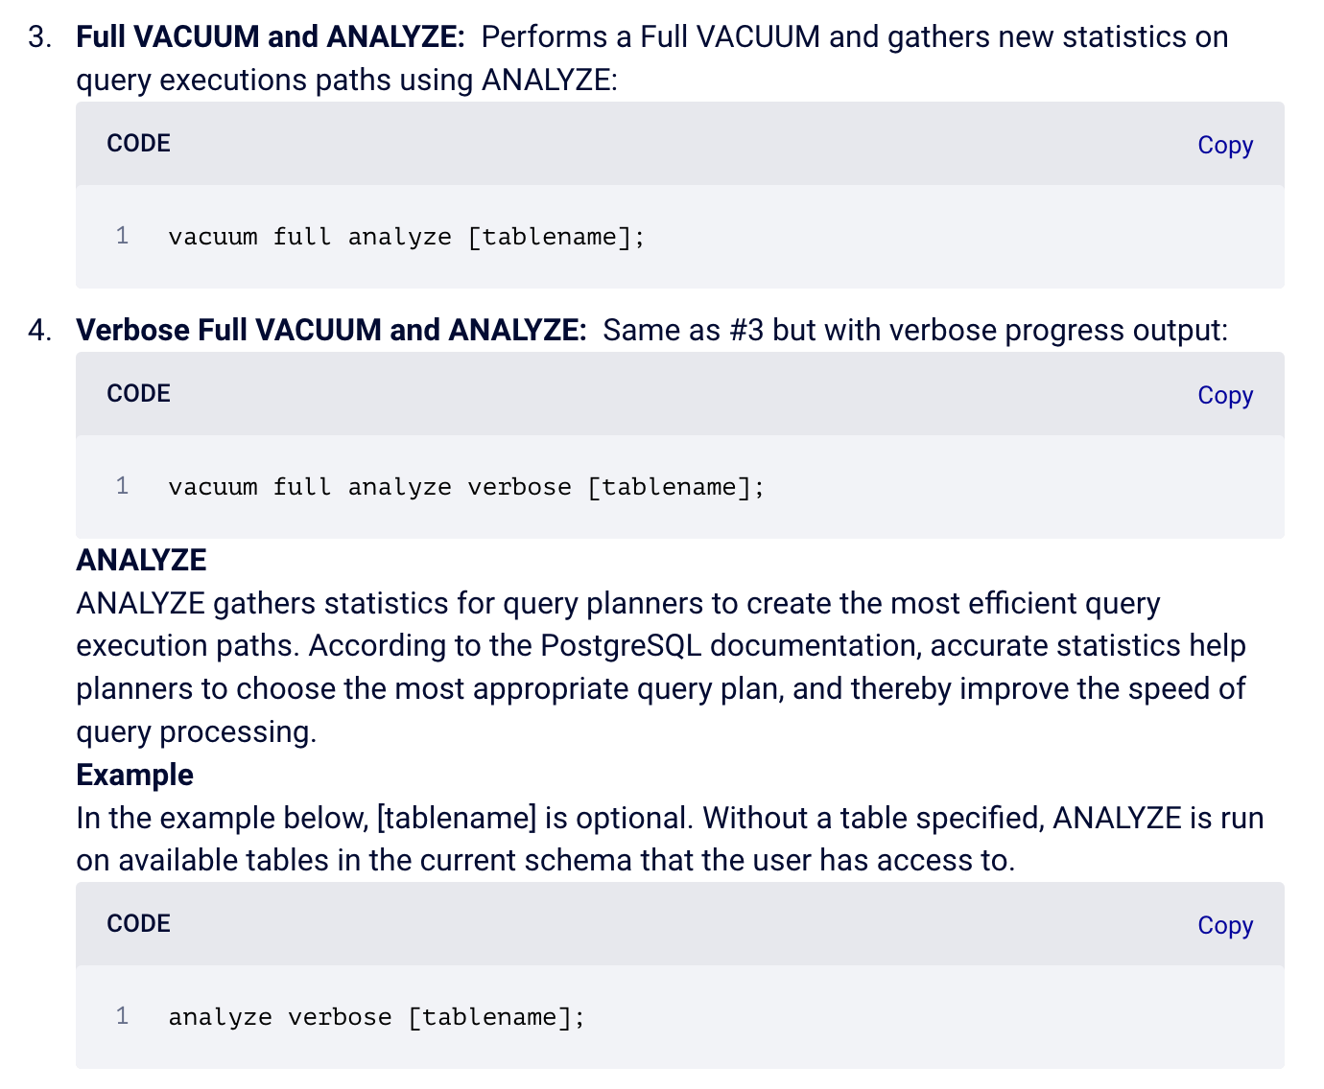
Types Vacuum

Slide 15
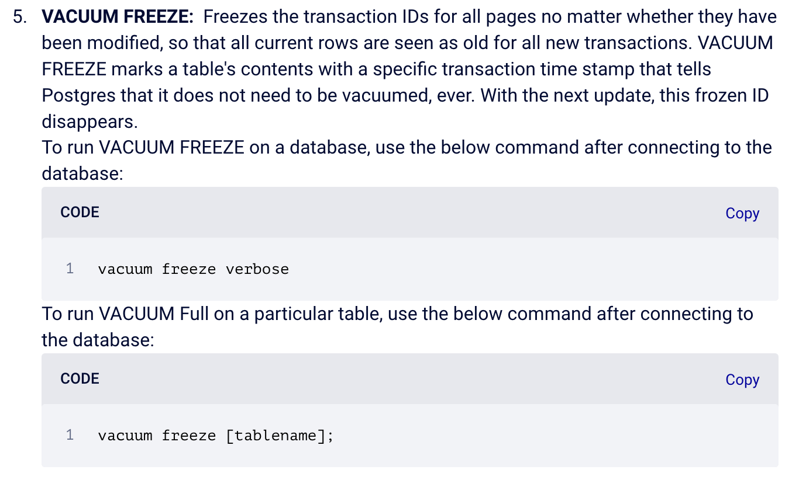
Types Vacuum

